Slide 1
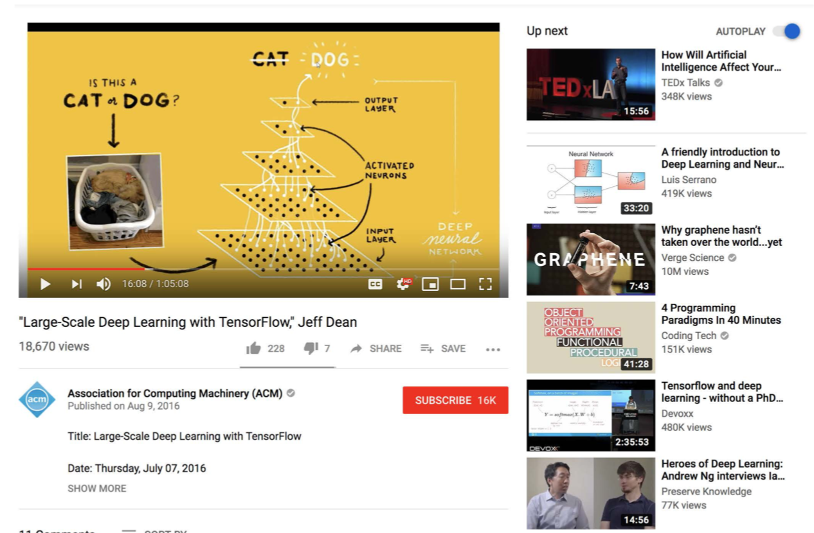
Recommending What Video to Watch Next: A Multitask Ranking System CSCE 670 PAPER BREAK DOWN
RISHABH GARG
UIN:130004847

Slide 2

Motivation, why is this paper interesting? What is it trying to do?
Youtube’s Movie Recommendation Algorithm and Paper Focus
The paper focusses on movies recommendation for users based on the movie they are currently watching. Since this paper is what Youtube is currently using as part of their recommendation system, it made me curious to look into the algorithmic details.
The basic idea used here is to learn multiple objectives from user’s previous history logs, namely engagement objectives and satisfaction objectives. The engagement objectives helps in identifying user’s involvement with a particular video like time spent and clicks count, and satisfaction objectives help in identifying user’s content with the video like number of likes, shares, thumbs downs and ratings.
Paper also discusses removal position bias involved due to users getting more engaged with videos appearing upper in the recommendations than the lower ones.

Slide 3
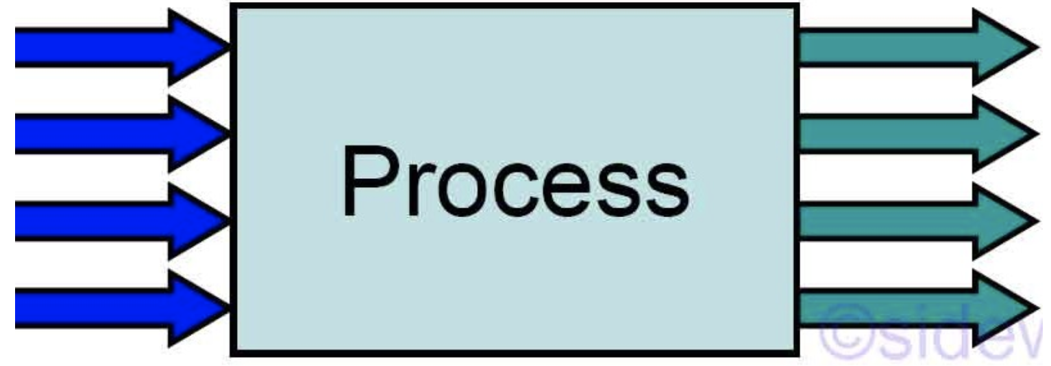
Motivation, why is this paper interesting? What is it trying to do?
Inputs and Outputs
Inputs:
Current movie is the query
Candidate movies retrieved from a candidate generation algorithm, applied to the user’s watch history logs
User’s watch history logs for retrieving features for Neural Network
Context which includes device location, current time and user demographics
Outputs:
Returns the probabilities of user clicking, liking, downvoting, spending time duration and rating the particular candidate videos. Rank those candidates on weighted combination of those probabilities and return n items with highest ranking.

Slide 4

Motivation, why is this paper interesting? What is it trying to do?
Candidate Generation
For candidate generation, the key idea is to find videos sharing at-least one aspect with the current video. The authors used features of the current video and found videos similar to it.
Another way used for generating candidates is to find movies watched next to this movie(by frequency). Afterwards, a set of those candidates is prepared for ranking them.
This paper focusses on ranking the candidates, rather than improvising or creating a candidate generation algorithm .

Slide 5
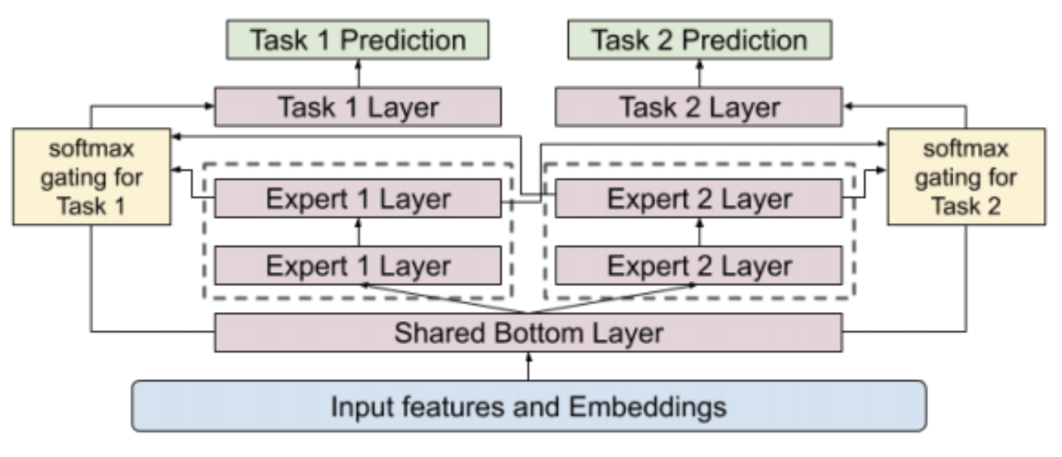
Technical contribution model detail
Multi-gate Mixture of Experts(MMOE)
Mixture of experts(MOE)
MOE refers to a machine learning technique used to provide the input tasks as a prediction responsibility to a combination of experts, wherein each expert is a neural network which is separately trained.
Multi-Gate
For every objective/task there is a gate function. Gate network is a linear network followed by a softmax function. This softmax function will determine which expert layers are important for the different objectives.
Structure
For MMOE, there is one gate per task, and common shared network of experts.
Output
The output of the experts n/w is weighted by the gate network and combined together.

Slide 6
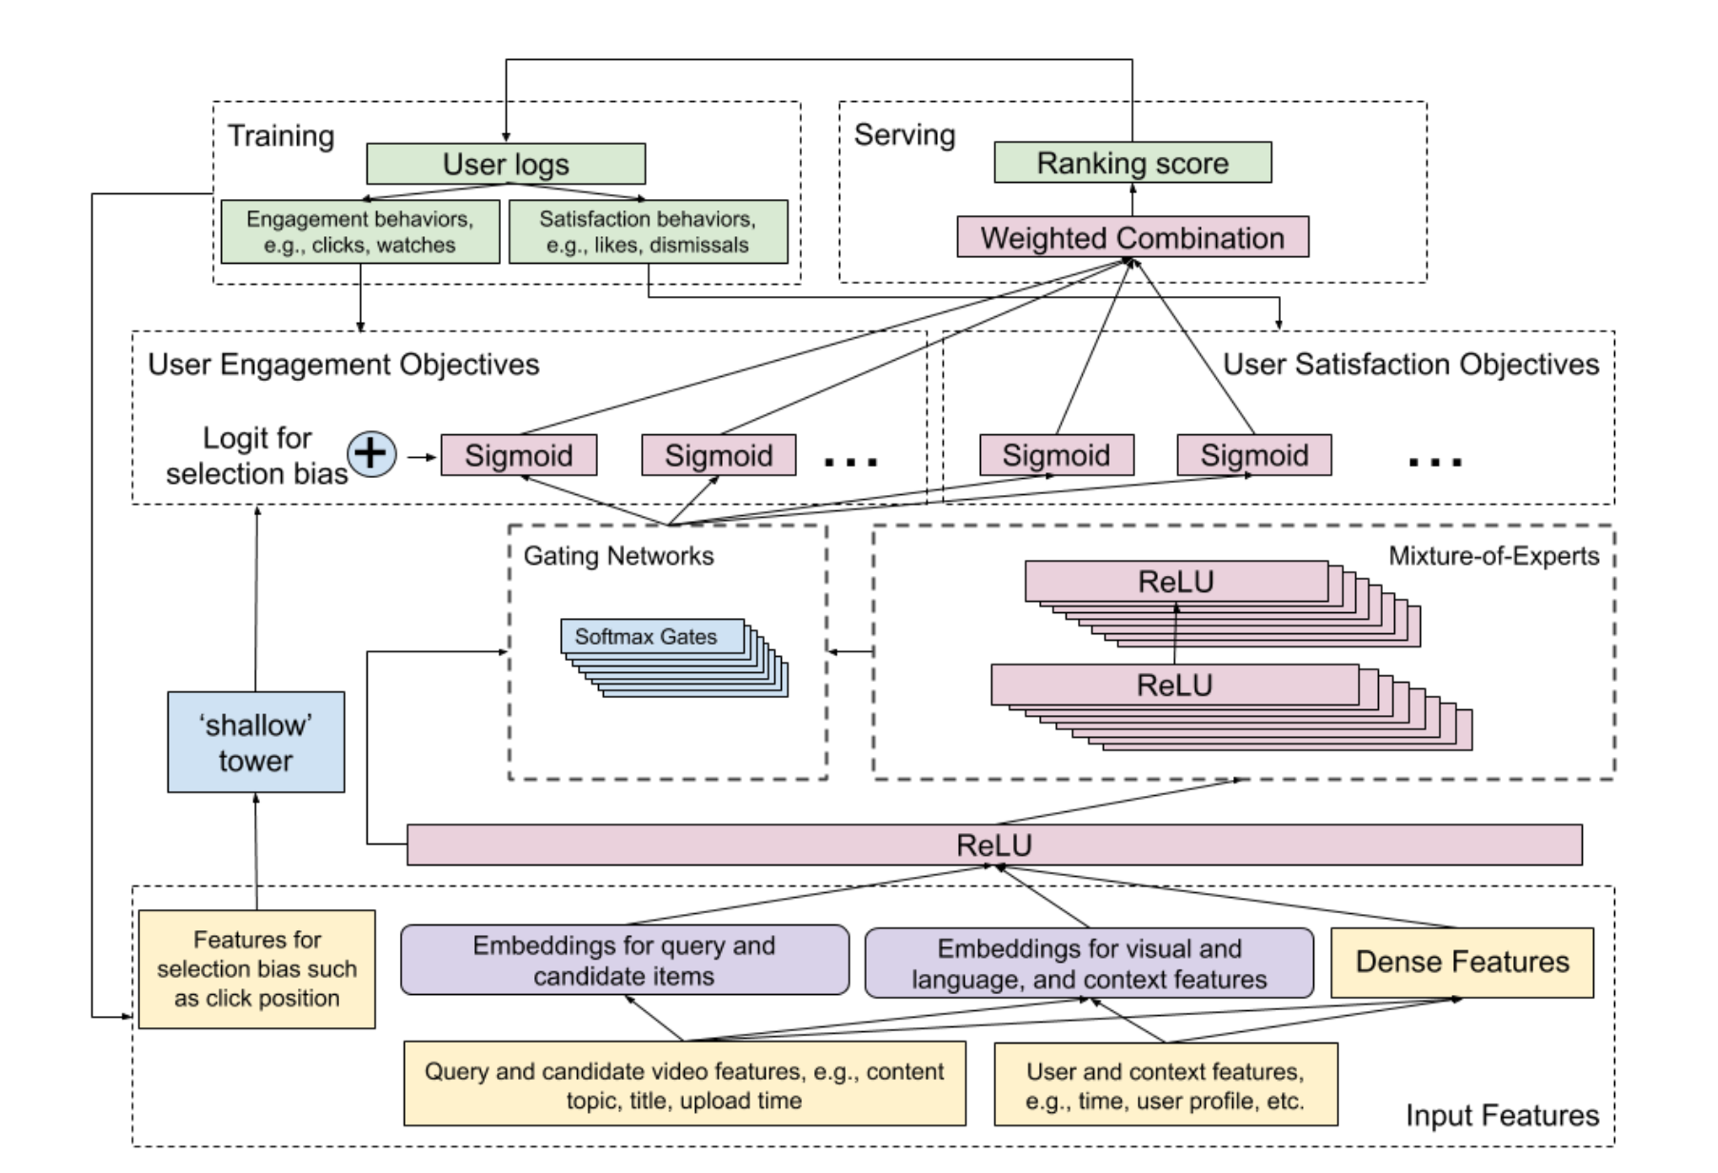
Main Technical contribution: Model Representation

Slide 7
Main Technical contribution: Model Explained
Multi-gate Mixture of Experts
For multi-task classification, authors used Multi-gate Mixture of Experts(MMOE) model on top of a hidden layer, wherein experts are shared across all the tasks(engagement and satisfaction), however a gating network(which takes information from the same shared hidden layer) decides the probability of each expert’s contribution for the particular task. It helps in modularising the information retrieved from the input features.
Unlike, a shared bottom model used for multi-task learning, it doesn’t require a lot of parameters and doesn’t create problems when the correlation between tasks is low.
Shallow Tower
Another main technical aspect involved is shallow side tower, which is used to remove position bias involved due to the higher position information being more selected by the user(referring to the candidates information in the user logs) and hence achieving a higher rank by the system. In this, a selection bias based feature, such as position of the candidate video when it was selected, is taken as part of the input features. A 10% dropout rate is applied to the feature, to prevent over reliance on this feature and hence removing the position bias.

Slide 8
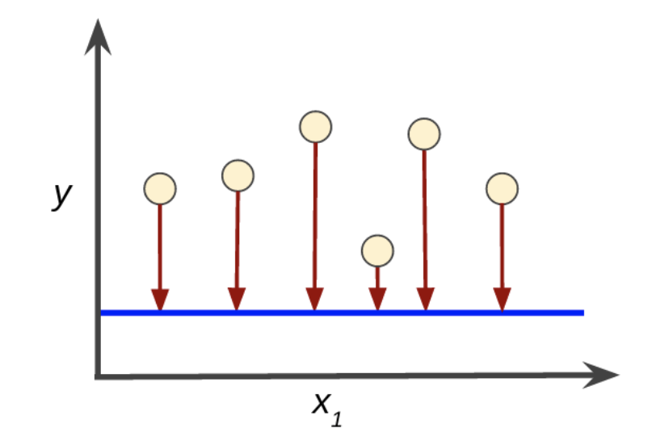
Main Technical contribution: Model Explained
Losses
The tasks incorporated by the model can be formulated as binary and classification tasks. For engagement based tasks, number of clicks is a binary task whereas time spent is a regression task. For satisfaction based tasks, hitting like is a classification tasks whereas rating is a regression task.
The authors used cross entropy loss for binary tasks and squared loss for regression task.
Dropouts
Gating networks have been known to cause imbalance expert distribution problem for MMOE. This means, it gives incorrect probabilities to the different experts, which are polarised towards particular experts. To remove this issue, a 10% dropout rate was applied to not use the gating networks at all and thus getting rid of the polarisation bias involved.

Slide 9

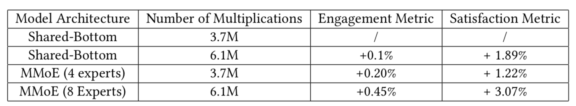
Interesting experimental result
Shared Bottom vs MMOE Performance
Below table shows how replacing the shared bottom architecture with MMOE improved the model’s performance for both engagement and satisfaction objectives.
Increasing the number of multiplications and number of experts improved the results further.

Slide 10
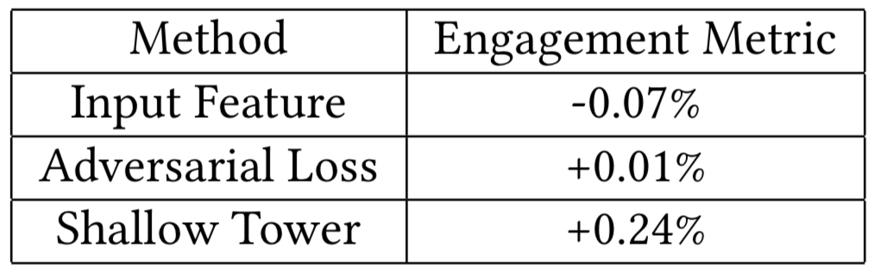
Interesting experimental result
Shallow Tower vs Adversarial Loss for Position Bias Removal
Below table shows how using shallow tower to remove selection bias boosts the engagement metrics.
While Adversarial Loss method increases the Engagement Metric by 0.01%, shallow tower increases it by a much larger amount, which is 0.24%

Slide 11
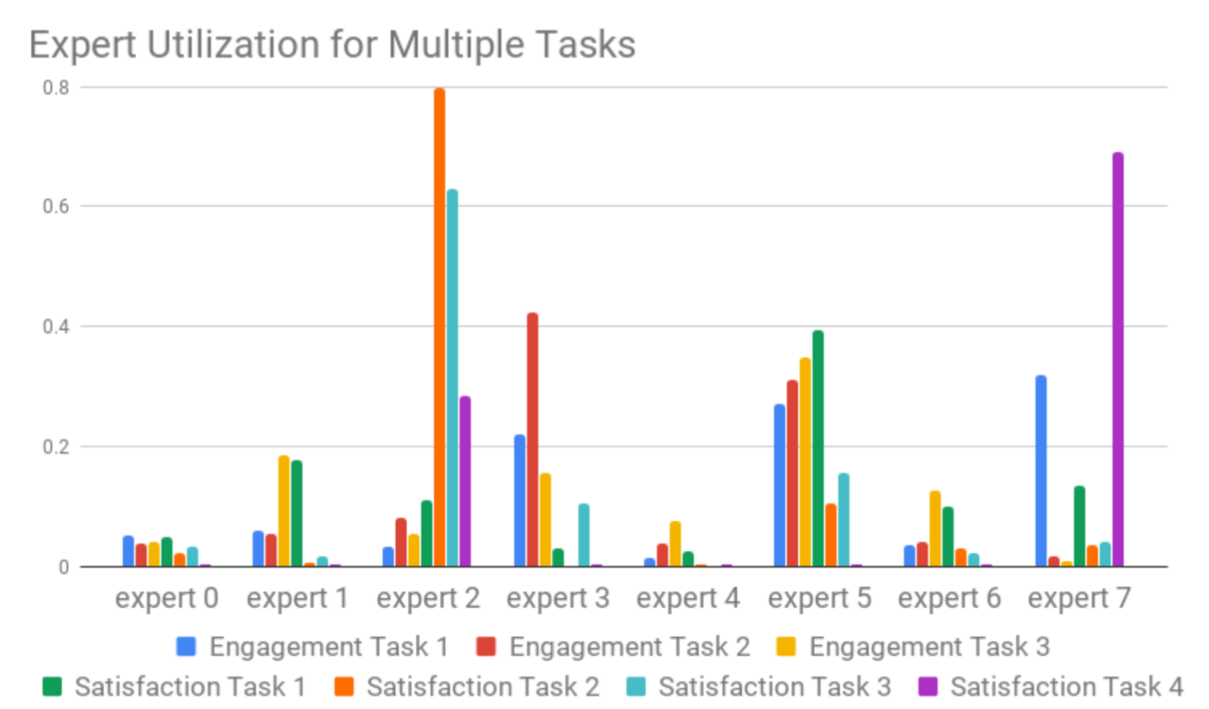
Interesting experimental result
Experts Contribution per Task
Below table refer to the each experts contribution(as predicted by the gating network) for each of the tasks.
This shows that some tasks may share multiple experts with other tasks.
For eg: Expert 2 and Expert 7 contribute towards Satisfaction Task 4, also relative to engagement tasks, satisfaction tasks tend to share small experts subset.

Slide 12
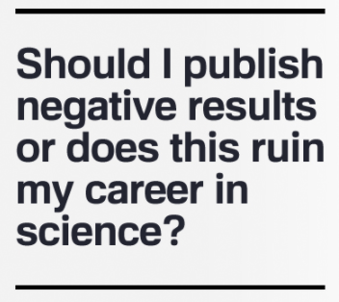
Limitations
Limitations
Experts can be increased to an extent
Although increasing number of experts helped in improvising the model’s performance, however it couldn’t be increased after a point as this model needs to be updated real-time, so the learning would impact the user experience.
Model less efficient for real-time serving
With the increasing number of features as well as candidates involved, the architecture may get impacted during future for serving as a lot of processing has to be done in real time.

Slide 13

Remarks
Remarks
MMOE better than Shared Bottom Model
MMOE model helps in learning multiple objectives and is more efficient than the shared bottom model. This is due the fact that we don’t know the hidden layers appropriate configuration beforehand for shared-bottom model to work perfectly as explained in [2].
Shallow tower better than traditional position bias removal methods
Shallow tower works quite efficiently in removing position bias as compared to the traditional methods like
Pointwise approach better than pairwise for real time serving
The authors used a pointwise approach instead of a pairwise or listwise approach. The latter ones could boost performance but pointwise is much faster and helps in real time serving.

Slide 14

Future work
Model Compression for real time serving
For ranking and recommendation models, some compression techniques can be incorporated which would increase the efficiency with respect to real time serving.
Unknown Biases
Though positional bias was successfully removed in the paper, some more models can be tried to explore unknown biases involved and hence resolve them.
Increase Model Stability
MMOE was a huge step over shared bottom architecture, however newer and better models are available now which improvises model stability. Below is one such paper:
“Jiaqi Ma, Zhe Zhao, Jilin Chen, Ang Li, Lichan Hong, and Ed Chi. 2019. SNR: Sub-Network Routing for Flexible Parameter Sharing in Multi-task Learning. AAAI (2019)”

Slide 15
REFERENCES
Zhao, Zhe, et al. "Recommending what video to watch next: a multitask ranking system." Proceedings of the 13th ACM Conference on Recommender Systems. 2019.
Tang, Bin, Malcolm I. Heywood, and Michael Shepherd. "Input partitioning to mixture of experts." Proceedings of the 2002 International Joint Conference on Neural Networks. IJCNN'02 (Cat. No. 02CH37290). Vol. 1. IEEE, 2002.
M. I. Jordan and R. A. Jacobs. 1994., Hierarchical Mixtures of Experts and the EM Algorithm. Neural Computation, vol 6, pp181- 214.

Slide 16

Paper Download link: https://dl.acm.org/doi/abs/10.1145/3298689.3346997

